Slide 1
"An Overview including Non-Motor Symptoms, eg Apathy" Hagop Bessos
History of Levodopa and Dopamine Agonists: Benefits and Myths.
Stanley Fahn MD, Columbia University, New York
Can We Predict And Therefore Minimise Falls in PD?
Lynn Rochester PhD, Newcastle University
Can We Predict Falls?
Colleen Canning PhD, Australia
Factors that Contribute to Falls
Anat Mirelman PhD, Tel Aviv
What is apathy?
Kathy Dujardin PhD, Lille University Medical Centre, France
Managing Peripheral Problems in PD Dr Lim Shen-Yang, Division of Neurology, University of Malaya
Synopses of the above topics available on Branch website, or by post from Olivia Bell

Slide 2
What can help us deal with apathy?
Apathy overlaps:
Anhedonia
Fatigue
Anxiety
So we need high reward
Great personal value
Differs by each individual
High reward leads to behaviour and action: vigour and persistence

Slide 3
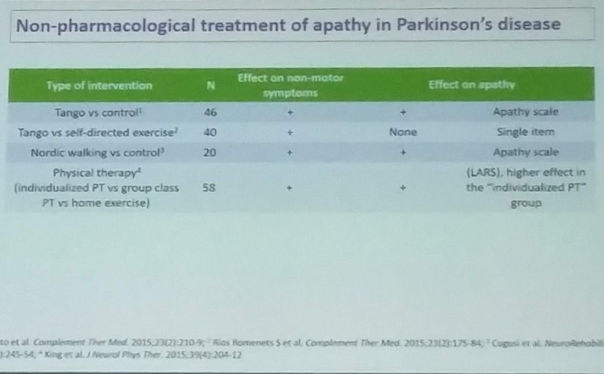
What’s suggested?
Non-pharmacological treatment of apathy in PD:
Tango
Nordic walking
Physical therapy one-to-one
“HHI stimulates the tactile sensory system via non-verbal communication. Interactions from hands, torso and arms form a sensory tactile communication channel about movement goals between partners during cooperative physical interactions.”

Slide 4
What can we do?
Identify the reward
People: Find an activity that involves other people – either one other person, or a like-minded group
Music and rhythm: Find an activity that is driven by music and/or rhythm
Get out into the open air (implied with Nordic walking).
Notes:
like a personal trainer or a physiotherapist where you are the centre of attention, the focus
non-verbal communication through touch, with ‘leader’ and ‘follower’ in

Slide 5
The key to motivation
Enjoyment :
In company with other people (HHI)
Being the focus of professional attention
& with music and/or rhythm

