Slide 1
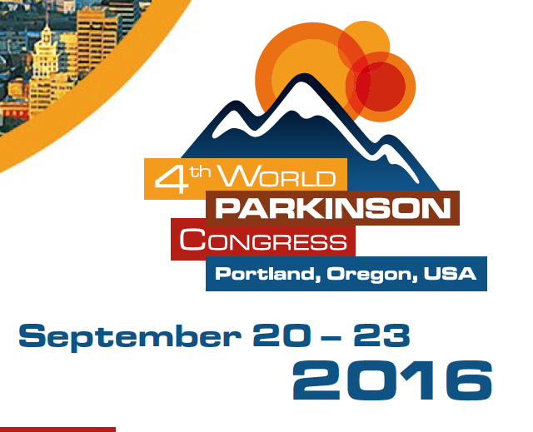

Slide 2
Plenary Session: An update of brain circuits in Parkinson’s and Deep Brain Stimulation

Slide 3
Deep Brain Stimulation Andres M Lozano, University of Toronto
Deep brain stimulation is the delivery of an electrical current to an area of the brain - in PD bilateral to the subthalamic nucleus (STN)
150,000 PD patients have received it worldwide and currently 10,000 patients per year
Notes:
DBS most common surgical treatment for PD

Slide 4
Deep Brain Stimulation Andres M Lozano, University of Toronto
Deep brain stimulation is the delivery of an electrical current to an area of the brain - in PD bilateral to the subthalamic nucleus (STN)
150,000 PD patients have received it worldwide and currently 10,000 patients per year
Best Outcome – Better quality of life with reduced motor fluctuations, tremor, rigidity, akinesia, gait and postural problems. Non-motor symptoms are resistant to surgery (Sleep problems, depression etc)
Notes:
DBS most common surgical treatment for PD

Slide 5
Deep Brain Stimulation Andres M Lozano, University of Toronto
MRI guided Focused Ultrasound (trans-skull penetration – i.e. no surgery) showed promising results in for essential tremor (n=40) (NEJM, 375,8 2016).
Notes:
Destry tissue in thalamusk known to cause the tremor

Slide 6
MRI guided Focused Ultrasound
Pretreatment
Post treatment

Slide 7
Parallel Session: Disease modification - an update on clinical trials

Slide 8
aSyn vaccines, passive immunization and novel small molecules (Eliezer Masliah)
Notes:
University of California
Passive immunization is direct introduction of these elements into the body, instead of production of these elements by the body itself.
exposing an animal to an immunogen in a controlled way, its body can learn to protect itself: this is called active immunization.

Slide 9
aSyn vaccine - active immunization
PD01A AFFITOPE (small aSyn peptide) – (Mandler, 2014)
tested in mouse models (Thy1.2-haSyn and pdgf-haSyn)
reduce cerebral aSyn
ameliorate neurodegeneration and dopaminergic loss in striatum
promote aSyn clearance by microglia
Phase I trial in 12 PD patients showed vaccine to be safe
50% of patients developed aSyn antiboides in blood and CSF
Phase IIA in PD and new trial in multiple system atrophy (MSA) patients.
Notes:
University of California
Passive immunization is direct introduction of these elements into the body, instead of production of these elements by the body itself.
exposing an animal to an immunogen in a controlled way, its body can learn to protect itself: this is called active immunization.

Slide 10
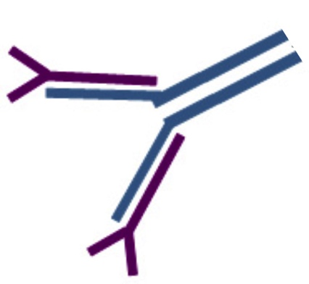
aSyn vaccine - passive immunization
Prothena/Roche
PRX002 vaccine - humanized 9E4 antibody that recognises aSyn 118-126
Phase 1A = 30 patients; Safe and well tolerated
Reduced aSyn levels in plasma after 1 administration
Phase 1B ongoing - ascending dose in PD patients.
Many reports from other groups on anti-aSyn antibodies protecting against dopamineric neurons loss

Slide 11
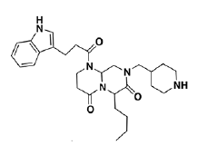
Small molecules against aSyn
Neuropore/UCB
NPT200-11 drug – similar to NPT100-18A
NPT100-18A experiments (Price et al, Brain, 2016)
reduce aSyn oligomer formation
reduce reduced aSyn toxicity,
ameliorate behaviour (mThy1-haSyn mouse model)
Phase I complete = 8 patients; Safe and well tolerated
Phase II in planning stages

Slide 12
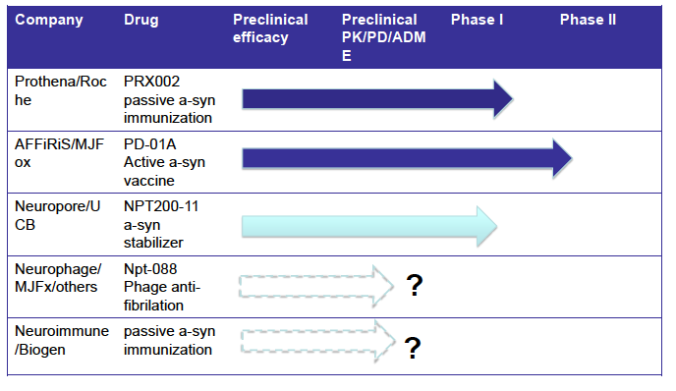
Clinical Trials with therapeutics against aSyn

Slide 13
Plenary Session Day 3 – Stem cells and iPS cells: where are we?

Slide 14
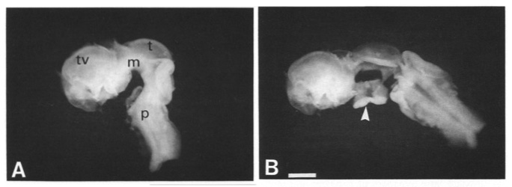
Cell Based therapies for Parkinson’s Disease: Past present and future (Roger Barker)
Cell replacement of lost DA neurons in PD
PAST - Fetal transplants in PD patients – variable results:
different doses of cells
different delivery method
different immunosupression
different primary end points

Slide 15
Cell Based therapies for Parkinson’s Disease: Past present and future (Roger Barker)
Cell replacement of lost DA neurons in PD
PAST - Fetal transplants in PD patients – variable results:
different doses of cells
different delivery method
different immunosupression
different primary end points
unilateral graft here
(¹⁸F-DOPA PET)

Slide 16
Cell Based therapies for Parkinson’s Disease: Past present and future (Roger Barker)
Cell replacement of lost DA neurons in PD
PAST - Fetal transplants in PD patients – variable results:
different doses of cells
different delivery method
different immunosupression
different primary end points
PRESENT - TRANSEURO using fetal grafts
better selection of patients (<65, <10 years duration, minimal LIDs)
same dose of cells, same delivery method,
same immunosupression, same 3 year end point (2020)

Slide 17
Cell Based therapies for Parkinson’s Disease: Past present and future (Roger Barker)
About 16 transplants between May 2015 – September 2016
At least 15 cancellations due to insufficient tissue

Slide 18
Cell Based therapies for Parkinson’s Disease: Past present and future (Roger Barker)
FUTURE – Stem cells (hESCs or iPSCs)
avoid ethical and logistical issues
controlled differentiation into a defined cell product
dopaminergic neurons from hESCs have similar efficacy to fetal ventral midbrain transplants

Slide 19
Cell Based therapies for Parkinson’s Disease: Past present and future (Roger Barker)
FUTURE – Stem cells (hESCs or iPSCs)
avoid ethical and logistical issues
controlled differentiation into a defined cell product
dopaminergic neurons from hESCs have similar efficacy to fetal ventral midbrain transplants
GForce-PD = global initiative in coordinating stem cell-based treatments for PD.
- CiRA - iPSC in PD trial in 2017 (Japan)
- NYSTEM trial hESC in PD in 2018 (USA)
- NeuroStemCellRepair hESC in PD in 2018/2019 (UK/Sweden)

Slide 20
June 2019

