Slide 1
Speech and Language Therapy Services for Parkinson’s in Lothian
Group Speech Therapy Supported Self Management
Talk to Edinburgh Parkinson's
By Isobel McCoy: January 2015

Slide 2
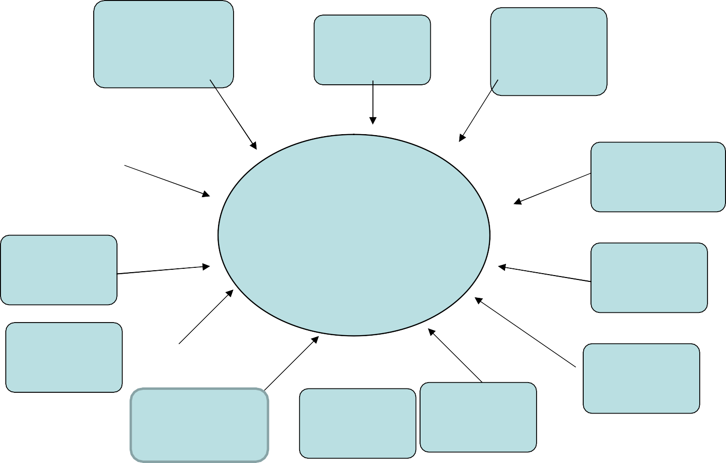
Communication Problems
Reduced facial expression
Mono loudness
Mono pitch
Talk too slow
Monotonous speech
Communication Problems
Talk too fast
Quiet voice
memory
Thought freezing
Word retrieval
Slurred Speech
Hoarse voice

Slide 3
Swallowing problems
Residue in mouth and
/or throat - sensation of “sticking”
drooling
Swallowing problems
Difficulty initiating swallow
Coughing or choking
Difficulty with oral preparation of food for swallowing

Slide 4
Causes of swallowing and communication problems
Rigidity
(muscle stiffness)
Reduced amplitude of movement
Hypokinesia
Perceptual problems
(Difficulty getting started /slow movement)
Bradykinesia

Slide 5
Impact
Communication
Reduced participation in social and work situation
Reduced expectation from family and friends
Further reduction in participation
Swallowing
Aspiration
Recurrent chest infection
Weight loss
Problems taking medication
Reduced social participation

Slide 6
Speech and Language Therapist Role
Assessment of communication and swallow and advise in partership with the client
Intervention to rehabilitate or maintain function
(e.g. Lee Silverman Voice Training?)
Education and supported self management
Intervention can be provided in both group and individual setting

Slide 7
Previous Service Model
Referral
Not sustainable
received
Limited choice
SLT assessment
Not always effective
4-6
weekly sessions at home
LSVT
Home visits perhaps not necessary
DISCHARGE
DISCHARGE

Slide 8
Current Service Model
EPAC SLT
Referral received
SLT
assessment
4-6 weekly sessions at home
Group therapy
LSVT?
Discharge
Bi-Annual SLT morning for discharged clients and partners/carers

Slide 9
Group Therapy Model
The group therapy model uses 'LSVT type’ of exercises in a solution focussed context promoting self management
The groups run weekly for 6 weeks and each session is of 90 minutes duration. Group size varies between 7 and 9 people and is facilitated by an SLT and SLT assistant.

Slide 10
GROUP ETHOS
Solution focussed
Share the solutions
Pool our resources

Slide 11
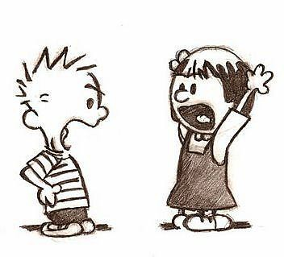
Exercises
To increase volume
To adjust rate
To increase clarity
To improve the intonation and get your personality back into your voice

Slide 12
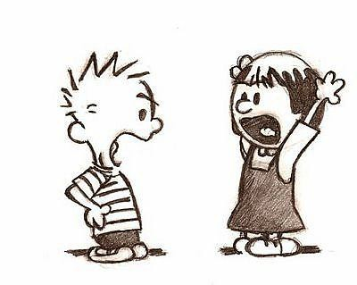
Big Ahs
Designed to train up the breathing muscles and voice box muscles
Improve coordination of voice and breathing
Get you used to using a louder voice again

Slide 13
The Long Loud Ahs
Say a Long Loud Ah
Time yourself and rate the quality out of 10
Repeat 15 times
Remember don’t push too hard as quality is more important than quantity

Slide 14
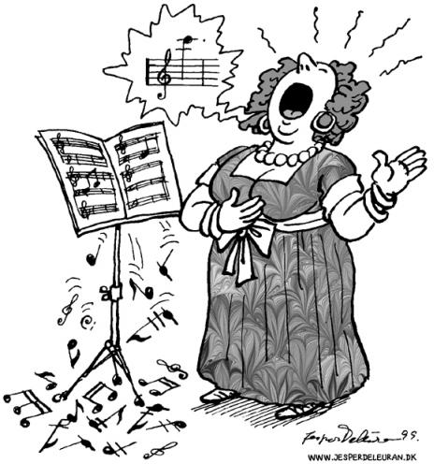
Pitch change Exercise ….going up
Say Ah as before but this time lift the pitch after about a second, and hold the higher note for 5 seconds
Only go as high as you comfortably can and keep the quality!

Slide 15
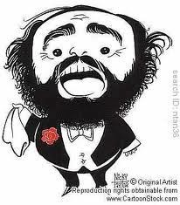
Pitch Change Exercise ..going down
Say Ah as before but this time drop the pitch after about a second, and hold the lower note for 5 seconds
Only go as low as you comfortably can and keep the quality!

Slide 16
Group Therapy Benefits
More effective as peer support and feedback is available to encourage development of skills in voice and speech production exercises and subsequent transfer of these skills to free conversations.
.• Improved patient experience from a social / participation point of view
Empowering as the Group Therapy model has a self management ethos at its heart

Slide 17
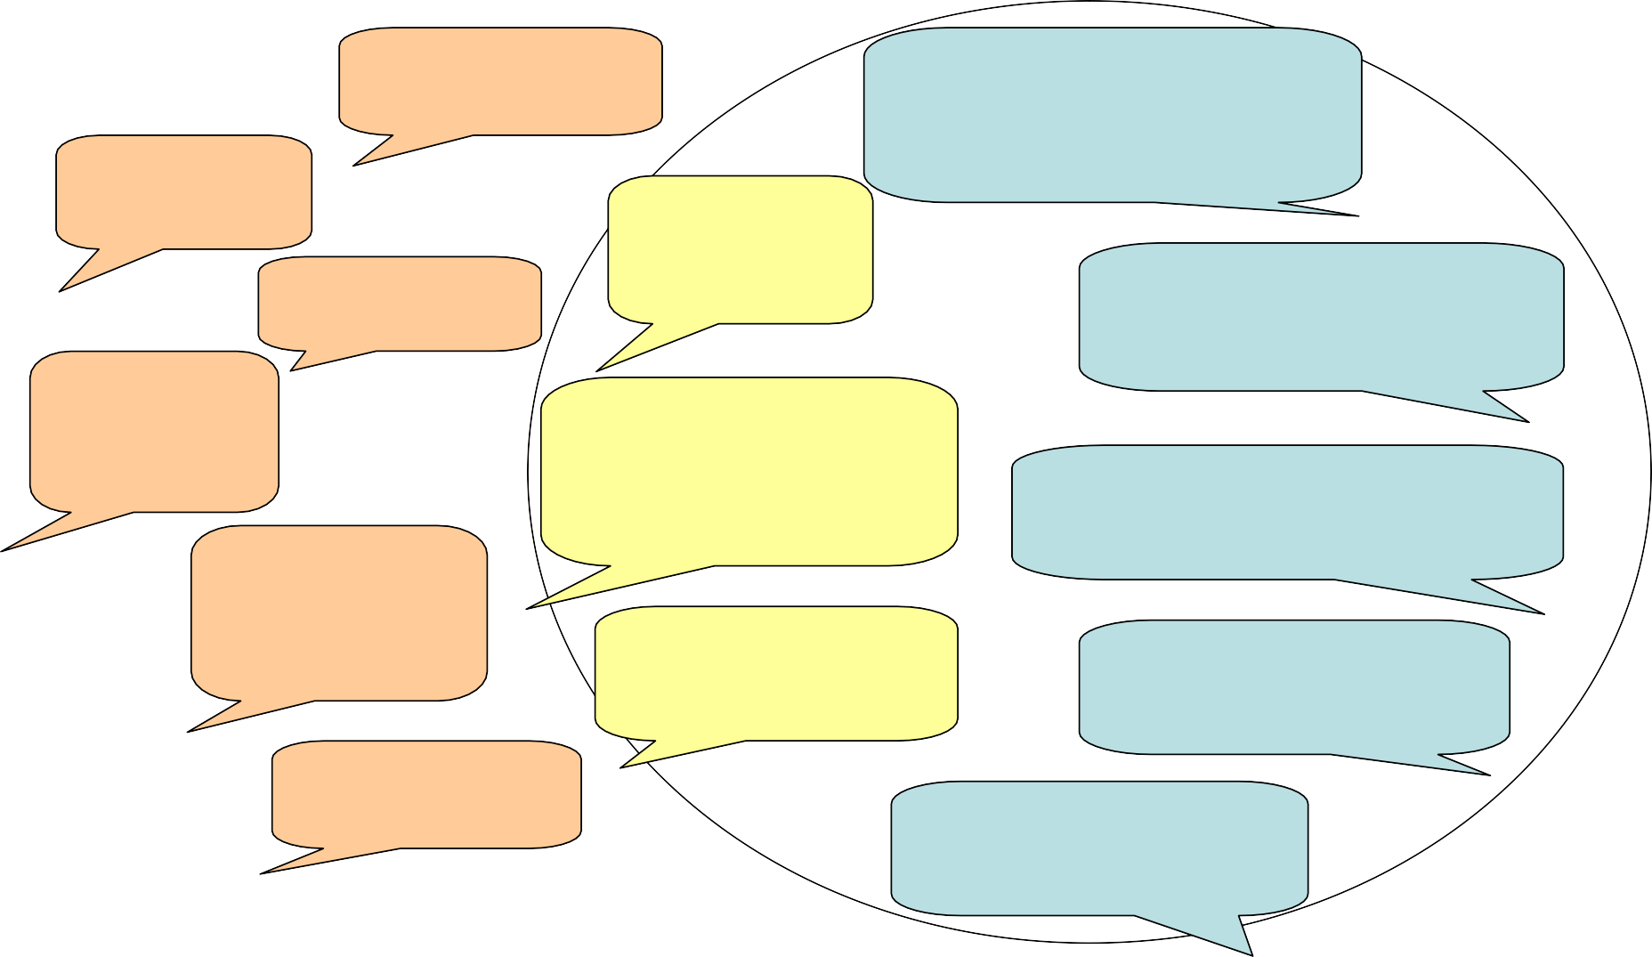
PERSONAL OUTCOMES
Self management
Participation
I try to speak louder
The grandchildren don’t move round me like a piece of furniture and they tell me I don’t whisper now
I take a deep breath
I explain the problem to people
I’m better if I slow down
It has improved my participation in technical and social conversations
Just think LOUD and shout it out
My voice is better when I’m not tired so I have a sleep before seeing people
Most of the changes are quite small but in total they make day to day more relaxed
I need reminding to use my LOUD voice
I “read” people’s faces so I know if I need to speak up
I feel more confident on the phone and in social gatherings
I open my mouth more
People listen to me and don’t talk over my head

Slide 18
Progress to Date in Edinburgh
Have run 9 groups between May 2010 and October 2014 (total of 50 people)
6-8 people per group, 6 weeks, 90 mins
1 SLT and 1 assistant
SFBT (Solution Focussed/ self management approach)
'LSVT type' exercises –focus on volume
Follow up morning for past group attendees
and partners/carers

Slide 19
What’s new in NHS Lothian SLT?
Single system
Parkinson’s Pathway Development Group
Equity and consistency across Lothian
Group Therapy model rolled out across Lothian
Patient involvement

Slide 20
What’s new in SLT Technology? i-pads and android tablets
Apps Pacesetter Paceboard Decibelmeter BlaBlaBla Speakup breathe2relax

